Slide 1

Events@Sathyabama
Project Supervisor: Dr. M. D. Anto Praveena
Name of the Student: Bandepalli Surya Anjani Kumar
Register Number: 40110156
19 April 2023
Department of CSE
1

Slide 2
Presentation Outline
Introduction
Objectives
System Architecture / Ideation Map
Module Implementation
Application Snapshots
Results and Discussions
Conclusion & Future work
References
19 April 2023
Department of CSE
2

Slide 3

Introduction
The Event Management System is a web-based application that simplifies the process of managing events within a college campus.
It can be used to advertise events to the whole college or a specific branch easily.
It provides a user-friendly interface for teacher to create and post events and for students to apply to events.
19 April 2023
Department of CSE
3

Slide 4

Existing System
With the rise of online platforms and the increasing demand for seamless event planning and execution, colleges are increasingly turning to event management systems to simplify the process.
However, the use of event management systems in college environments raises questions about their
Effectiveness,
Security and
User-friendliness.
19 April 2023
Department of CSE
4

Slide 5

Proposed System (Objectives)
The primary goals of this project were to create a web application with the following features:
Simplify the Process of Managing Events
Event Organization
Event Updation
Ensuring Proper Approval of Events through the College Admins Hierarchy.
Smart Authentication and User Management
Event Applications Management.
Easy event search and display.
Display complete details of each event.
19 April 2023
Department of CSE
5

Slide 6
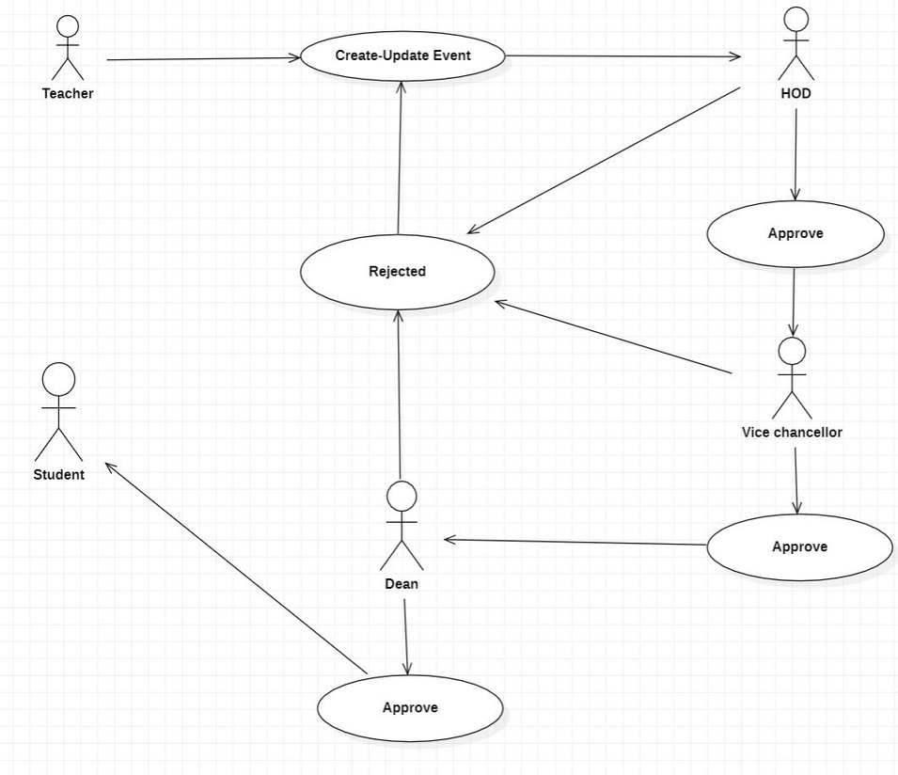
System Architecture
Use Case Diagram
19 April 2023
Department of CSE
6

Slide 7

Project Implementation (Tech Stack)
Front-End (Client-Side):
NextJS
ReactJS
TypeScript
ES Lint
JavaScript ES6
Material UI
HTML5
CSS3
Tailwind CSS
Axios, formik, yup, dayjs, prettier & other npm libraries
19 April 2023
Department of CSE
7

Slide 8
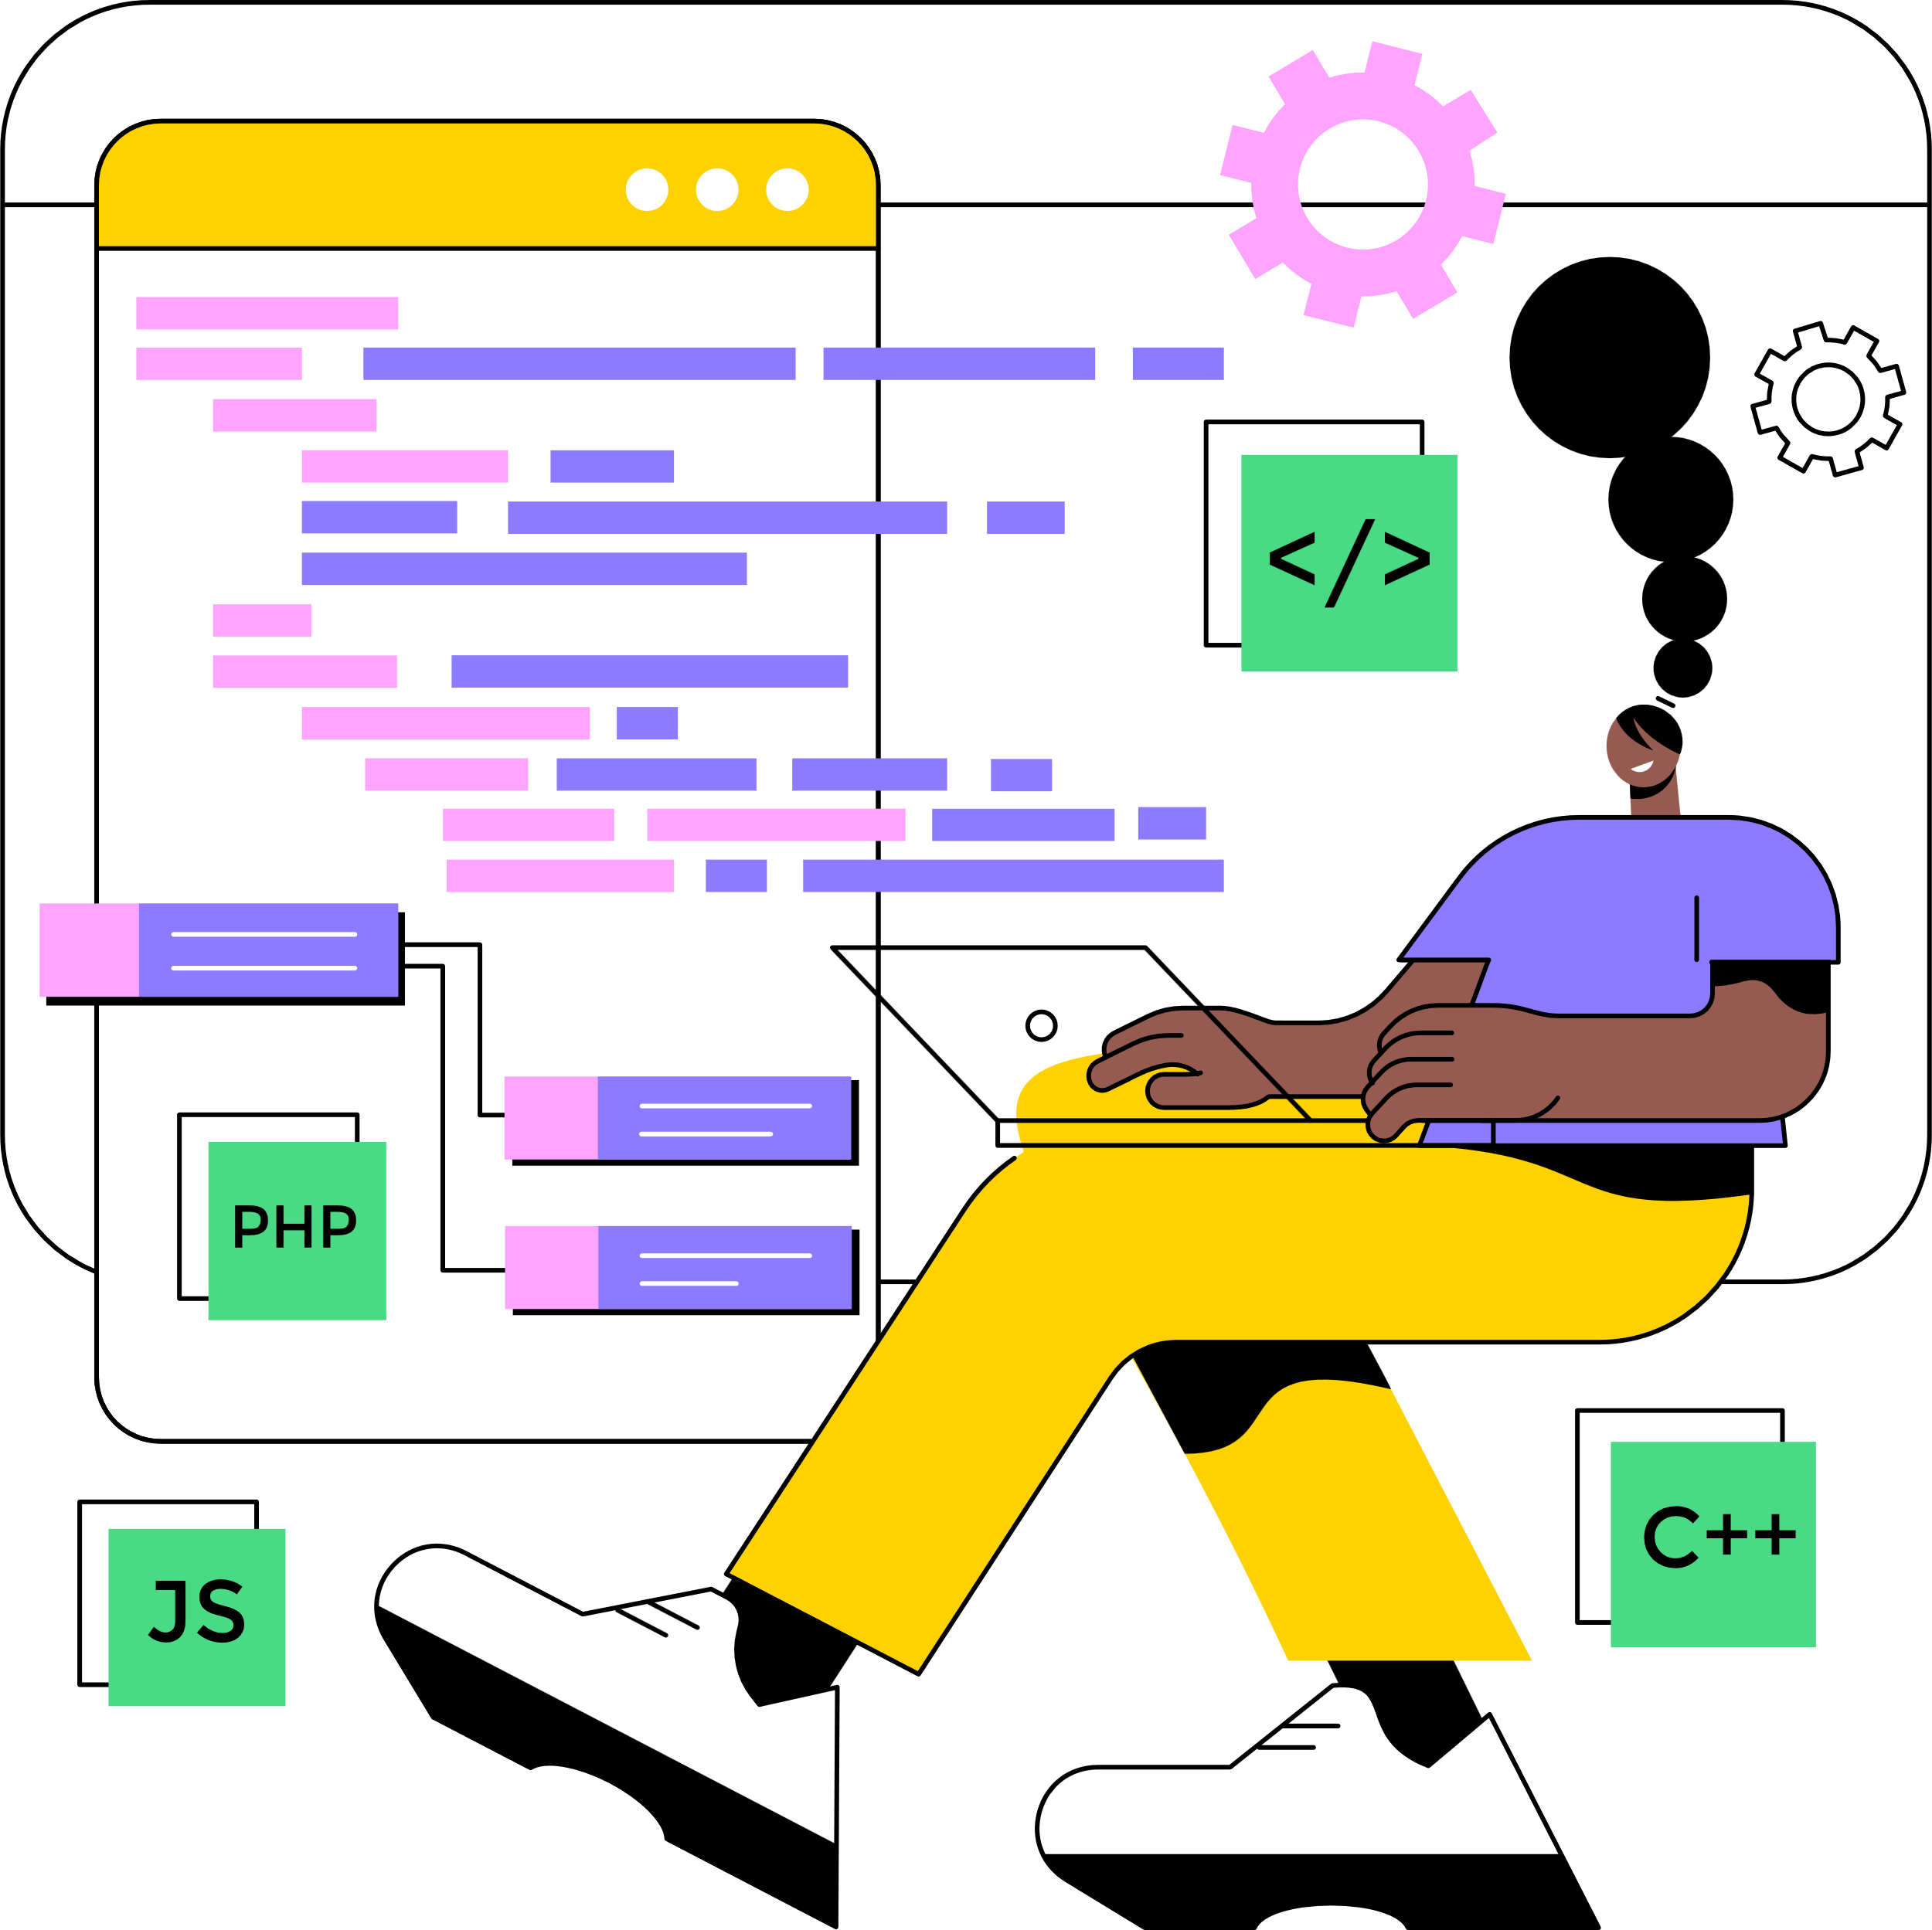
Project Implementation (Tech Stack) Ctd.
Back-End (Server-Side):
Django
Django REST Framework
MySQL
Deployment
Sathyabama Cloud
GCP (Google Cloud Platform)
Vercel (NextJS Server)
19 April 2023
Department of CSE
8

Slide 9

Key Features
Smart Authentication
Database Password Encryption
Smart Search
Quick-Apply
User Friendly Dashboard and UI
Server Side Rendering
Login Session State Holder
Seperate View for Each Admin Category.
19 April 2023
Department of CSE
9

Slide 10

User Requirements
Hardware Requirements:
CPU: Intel Pentium 4 or later
RAM: 2 GB or higher
Storage: 2 GB available space recommended
Internet Connection: Required
Software Requirements:
The latest version of any Browser (Chrome Recommended)
19 April 2023
Department of CSE
9

Slide 11
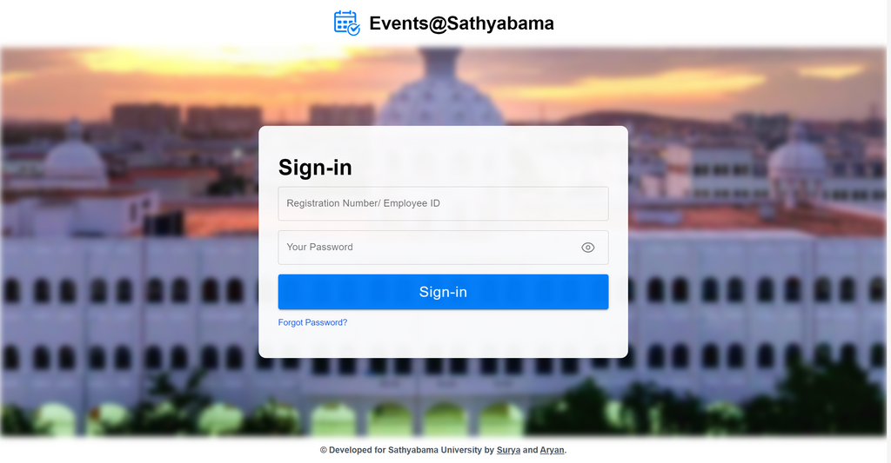
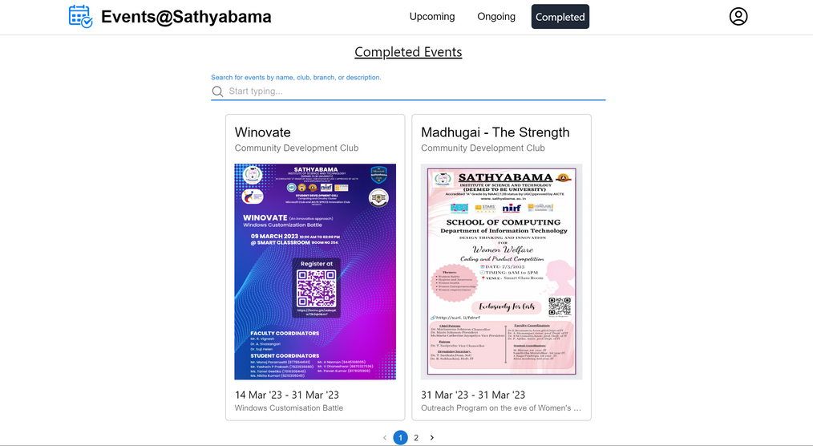
Sample Snapshot / Ideation Map
Sign-In
Home
19 April 2023
Department of CSE
10

Slide 12
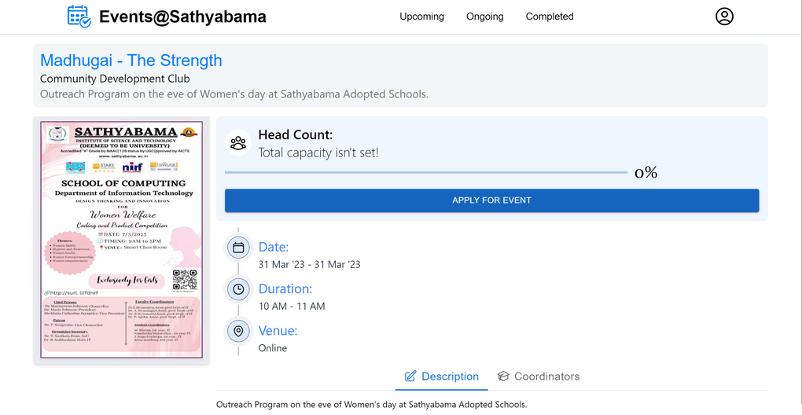
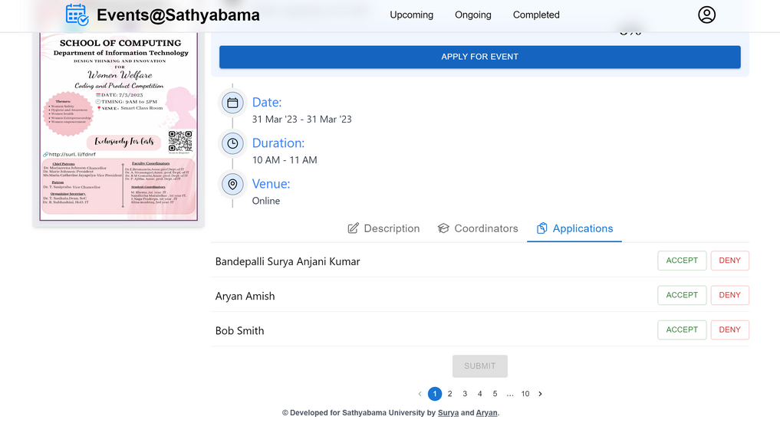
Sample Snapshot / Ideation Map
Details
Applications
19 April 2023
Department of CSE
11

Slide 13
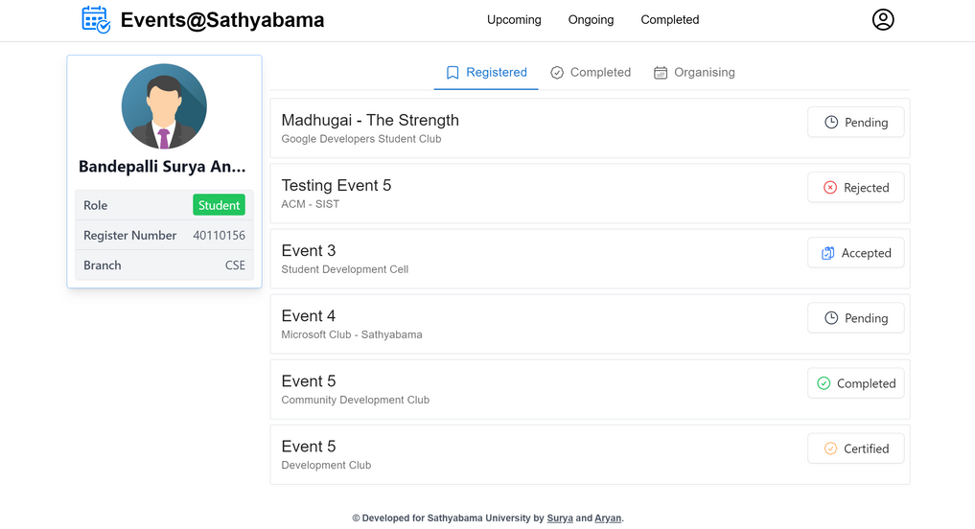
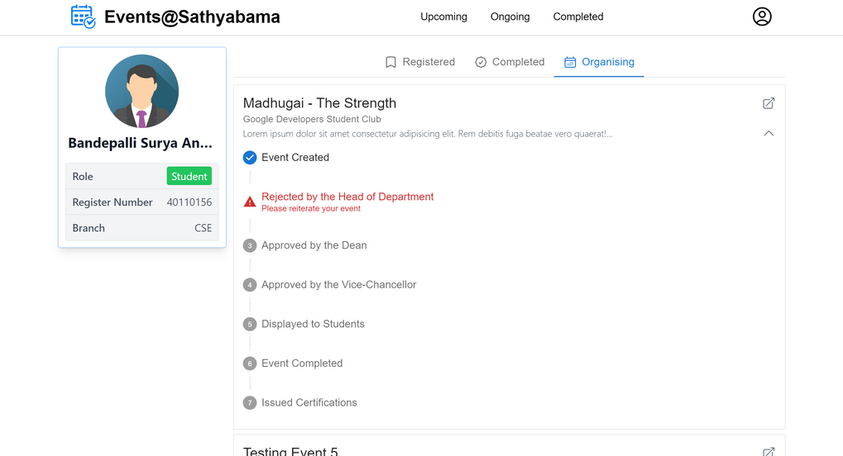
Sample Snapshot / Ideation Map
Profile
Organiser's Profile
19 April 2023
Department of CSE
12

Slide 14
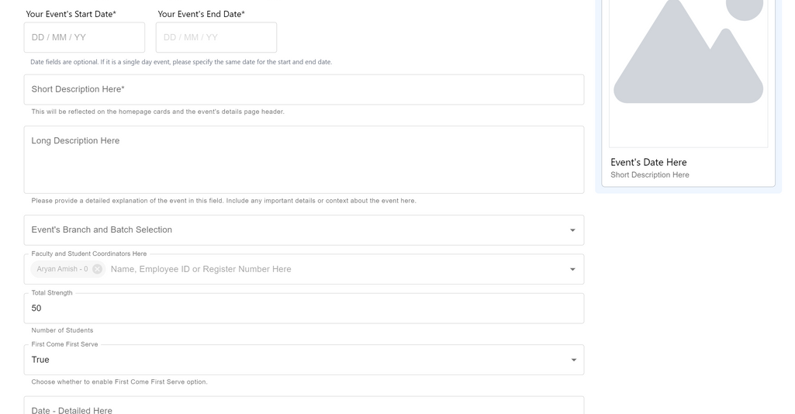
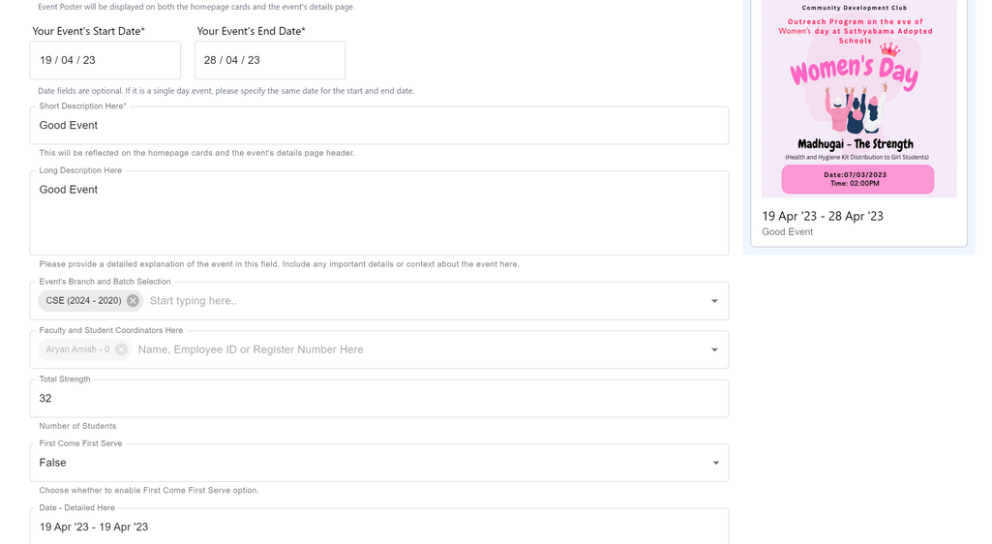
Sample Snapshot / Ideation Map
Event Creation
Event Updation
19 April 2023
Department of CSE
13

Slide 15

Conclusion
The Event Management System for a college streamlines the process of managing events in a college.
The system increases efficiency and streamlines event management, allowing teachers to focus on creating great events.
The Event Management System is a valuable tool for any college looking to manage their events more efficiently.
With its user-friendly interface and robust features, it can help colleges streamline their event management process and provide a better experience for both teachers and students.
19 April 2023
Department of CSE
14

Slide 16
References
1. Django documentation.
https://docs.djangoproject.com/en/3.2/
2. Django Rest Framework documentation.
https://www.django-rest-framework.org/
3. Next.js documentation.
https://nextjs.org/docs/getting-started
4. Tailwind CSS documentation.
https://tailwindcss.com/docs
5. React documentation.
https://reactjs.org/docs/getting-started.html
6. MySQL documentation.
https://dev.mysql.com/doc/
7. "Event Management System: A Comprehensive Guide" by John Smith, published in Event Planning Journal, vol. 20, no. 2, pp. 30-45, 2020.
8. "Designing Distributed Systems: Patterns and Paradigms for Scalable, Reliable Services" by Brendan Burns, published by O'Reilly Media, 2018.
9. "Clean Architecture: A Craftsman's Guide to Software Structure and Design" by Robert C. Martin, published by Prentice Hall, 2017.
19 April 2023
Department of CSE
15

Slide 17
THANK YOU!
19 April 2023
Department of CSE
16

